Slide 1
HEALTHCONNECT CLINIC
WEEK 5 PROJECT SUMMARY
Data Analytics Track
Exploratory Analysis • KPI Development • Business Insights
Prepared by: Dawodu Fehintoluwa Bukola
HealthConnect | Week 5 Project Summary
1

Slide 2
01 Week 5 Objective
Moving from initial data understanding to actual analysis
What was addressed
Key analytical principle
• Data preparation and quality checks.
• Exploratory analysis of attendance, no-shows and cancellations.
• KPI development and calculation.
• Identification of factors associated with missed appointments.
• Initial Power BI analytical visualisation.
• Business insights to guide potential actions.
The analysis identifies patterns and associations. It does not assume that an observed relationship proves causation.
Key question: What factors are associated with patients attending, cancelling or missing appointments?

Slide 3
02 Data Preparation
Summary of the Week 5 data-quality work
DATA TYPES
DUPLICATES
Variables were reviewed and data types were checked.
No duplicate records were identified; appointment IDs were unique.
MISSING VALUES
INCONSISTENCIES
Distance to Clinic: 90 records. Waiting Time: 60 records.
No specific inconsistent values were identified in the documented checks.
ORIGINAL DATA
IMPLICATION
The original dataset was retained and not overwritten.
Distance and waiting-time analyses require documented treatment of missing observations.
HealthConnect | Week 5 Project Summary
3

Slide 4
03 Exploratory Data Analysis
Patterns investigated in the appointment data
Appointment characteristics
Patient characteristics
Previous history
Appointment type • Appointment day • Cancellations
Age group • Gender
Previous no-shows vs current outcome
Reminders
Operational factors
Outcomes
SMS • Email • WhatsApp • No Reminder
Distance to Clinic • Waiting Time
Attended • No-Show • Cancelled
HealthConnect | Week 5 Project Summary
4

Slide 5
04 KPI Development
Selected KPIs from the Week 4 potential KPI list
NO-SHOW RATE
ATTENDANCE RATE
CANCELLATION RATE
48.46%
46.28%
5.26%
No-show appointments ÷ total appointments × 100
Attended appointments ÷ total appointments × 100
Cancelled appointments ÷ total appointments × 100
Why it matters: Shows the scale of missed appointments.
Why it matters: Measures appointment compliance.
Why it matters: Separates cancellations from no-shows.
HealthConnect | Week 5 Project Summary
5

Slide 6
05 Key Findings
Meaningful observations from the Week 5 analysis
No-shows are the largest outcome
Attendance is below half
48.46% of appointments were no-shows.
46.28% of appointments were attended.
Implication: Prioritise missed-appointment reduction.
Implication: Investigate factors linked to low attendance.
Booking Lead days
Reminder pattern observed
Patient with longer lead days are less likely to attend their appointment
Patients without reminders were more likely to miss appointments.
Implication: Consider reducing the number of days between booking and appointment.
Implication: Review reminder coverage and channel effectiveness.
Previous no-show pattern observed
Data gaps remain
Patients with a history of missed appointments were more likely to miss again.
90 distance and 60 waiting-time values are missing.
Implication: Consider targeted follow-up for repeated no-show patterns.
Implication: Complete and document missing-value treatment.
HealthConnect | Week 5 Project Summary
6

Slide 7
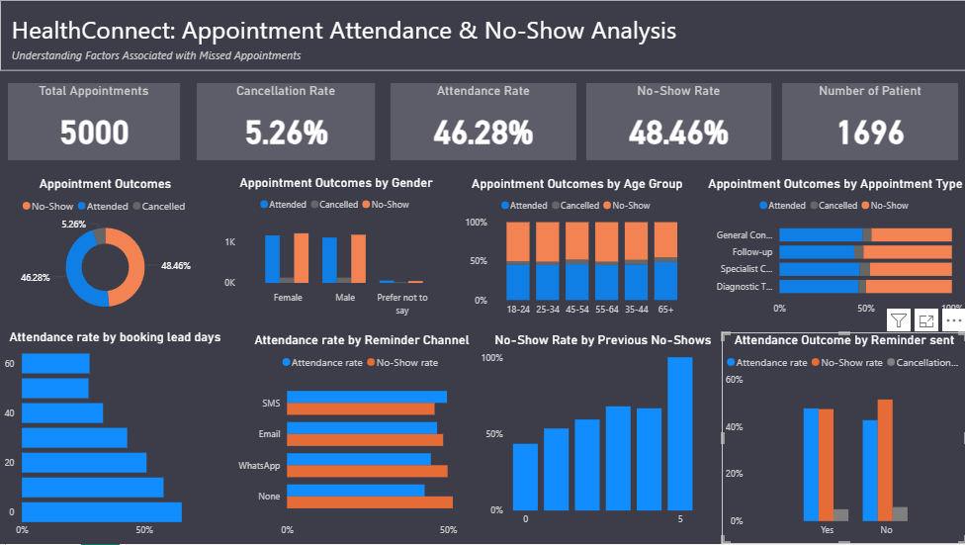
06 Dashboard / Visualisation
Initial Power BI analytical dashboard

Slide 8
07 Recommendations & Limitations
Responsible next steps based on the current evidence
Business recommendations
Limitations
• Prioritise no-show reduction.
• Review reminder coverage and channel performance.
• Consider targeted follow-up for repeated no-show patterns.
• Improve completeness of distance and waiting-time data.
• Consider reducing the time between booking lead time and appointment
• Continue monitoring attendance, no-show and cancellation KPIs.
• Dataset is fictional and may not fully represent real-world behaviour.
• Some reasons for missed appointments are not captured.
• Distance and waiting time contain missing values.
• Associations do not establish causation.
• Some relationships require further statistical validation.
HealthConnect | Week 5 Project Summary
8

Slide 9
08 Next Analytical Focus
Completing and strengthening the HealthConnect analysis
1. COMPLETE CLEANING
2. COMPLETE KPIs
Document missing-value treatment and validate the analysis-ready data.
Calculate Repeat No-Show Rate and Reminder Attendance Rate.
3. DEEPEN EDA
4. REFINE DASHBOARD
Quantify distance and waiting-time relationships and compare rates.
Keep visuals directly linked to the business questions.
5. VALIDATE INSIGHTS
6. FINALISE RECOMMENDATIONS
Use further analysis before treating patterns as actionable evidence.
Translate validated findings into targeted operational actions.
Week 5 outcome: move from initial data review to evidence-based analysis and business insight.
HealthConnect | Week 5 Project Summary
9

